Slide 1

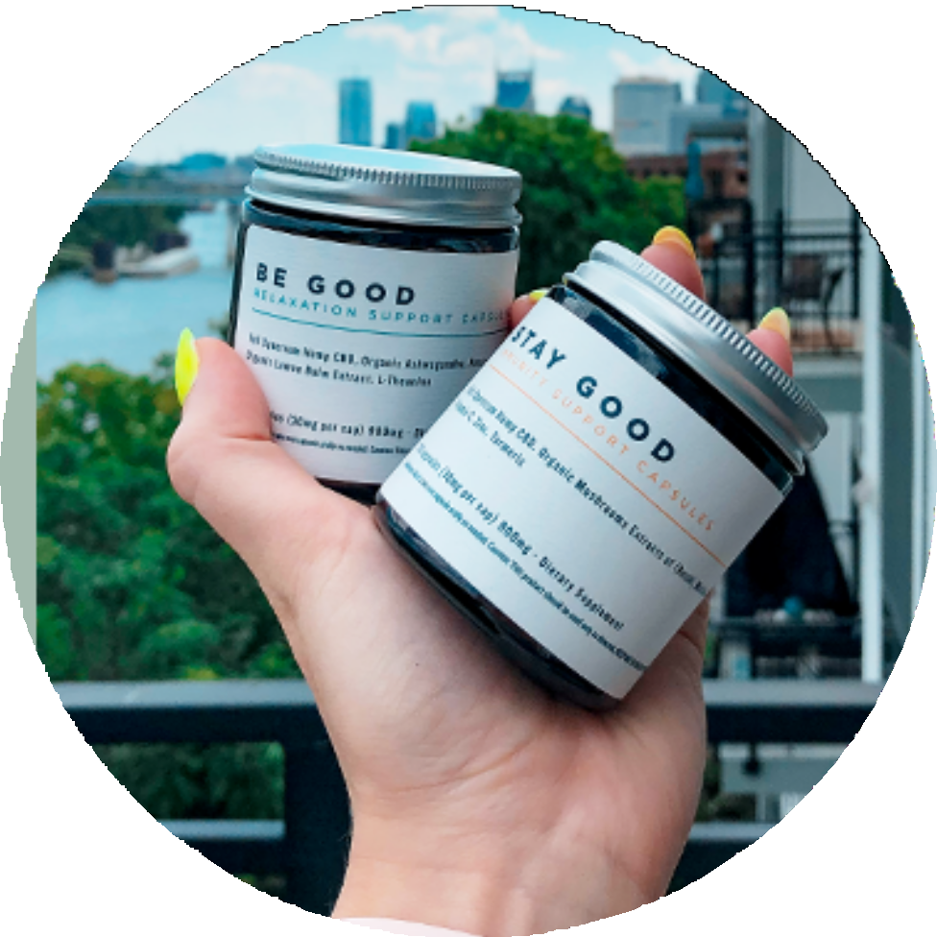

TOP-QUALITY HEMP PRODUCTS
HEMP GOODS FOR EVERYONE IN YOUR LIFE

Slide 2
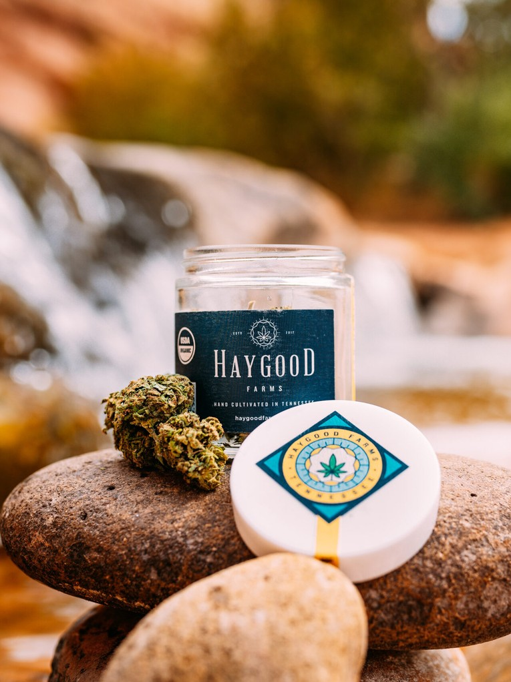
WHY HAYGOOD
Haygood Farms provides premium products to help individuals improve their quality of life with Good Clean Fun.

Slide 3
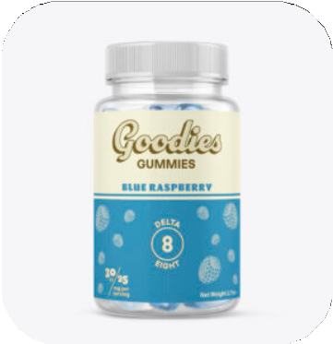
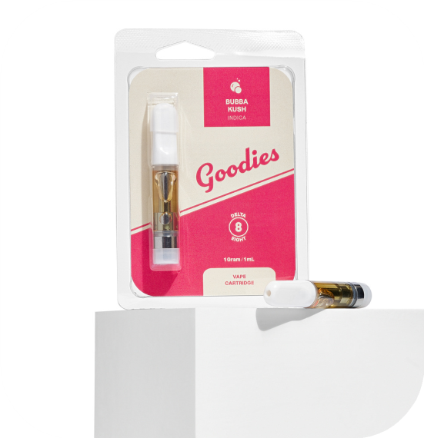
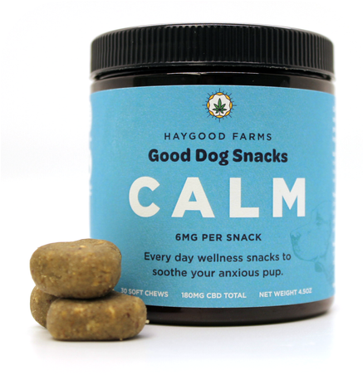
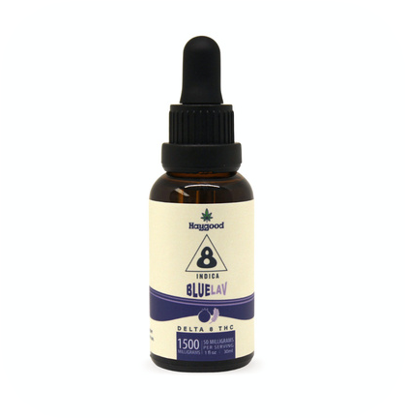
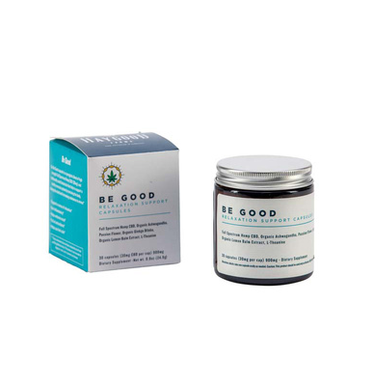
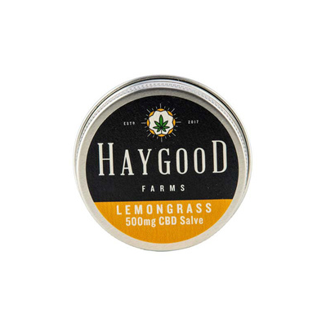
OUR
SHOP
Blue Raspberry Goodies Gummies
Wedding Cake Delta Cartridge
Good Dog Snacks
– Calm
Blueberry-Lavender Delta 8 Oil
Be Good Relaxation Capsules
Full-Spectrum Lemongrass Salve

Slide 4
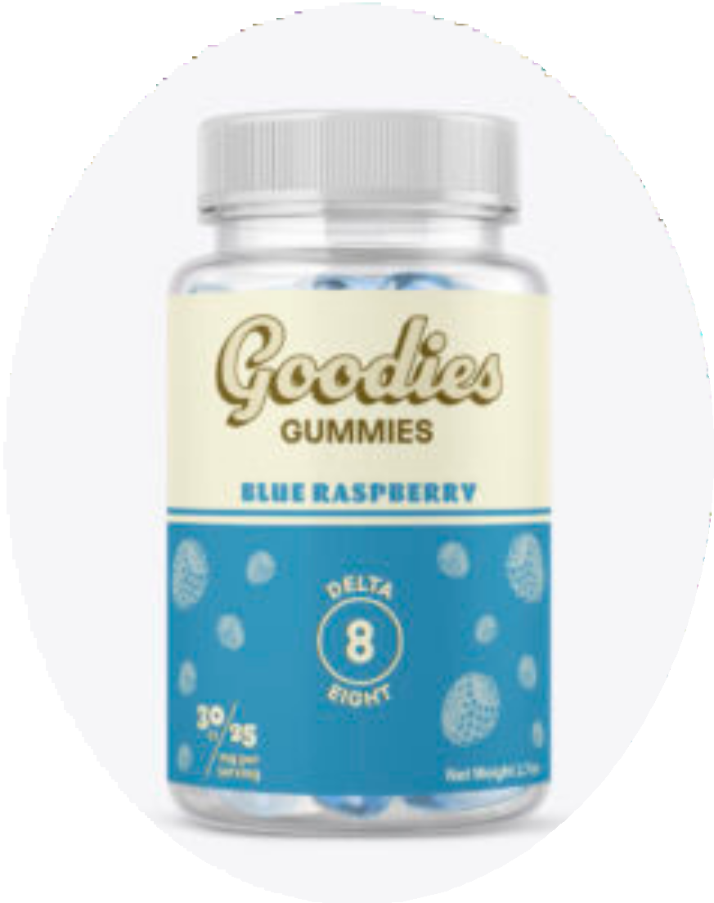
BLUE RASPBERRY GOODIES GUMMIES
OUR BLUE RASPBERRY GOODIES GUMMIES ARE GLUTEN-FREE, VEGAN GUMMIES THAT PROMOTE A SENSE OF UPLIFTING CALM.

Slide 5
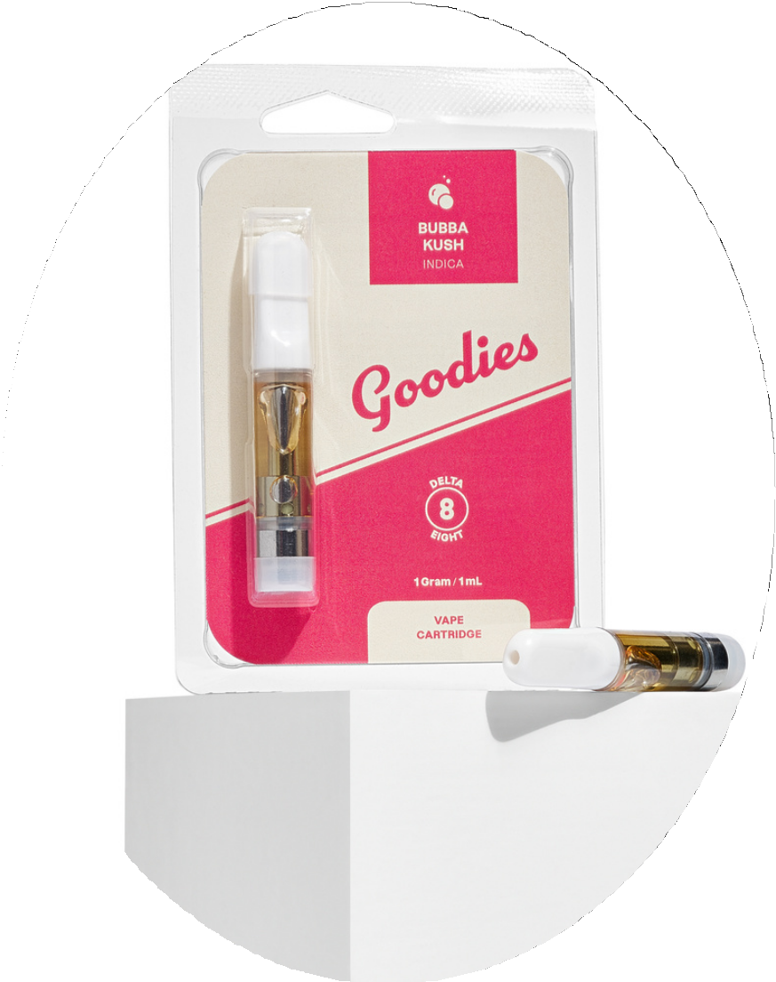
WEDDING CAKE DELTA 8 1G CARTRIDGE
THIS STAYS TRUE TO ITS NAME, PRODUCING CREAMY TOKES WITH HINTS OF EARTHY LEMON AND VANILLA, IT’LL BE SURE TO SATISFY YOUR SWEET TOOTH.

Slide 6
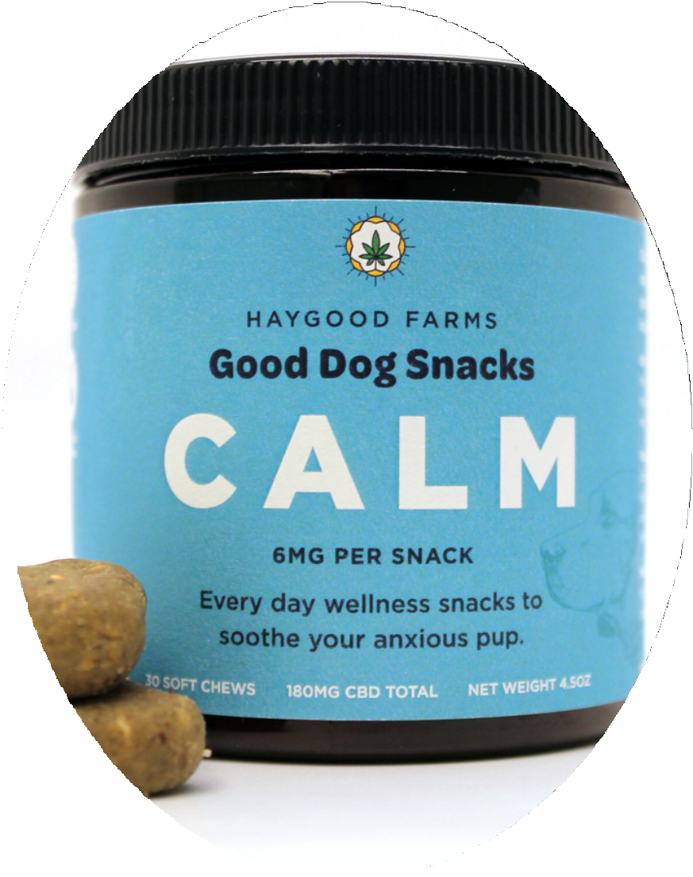
GOOD DOG SNACKS – CALM
OUR GOOD DOG SNACKS, INFUSED WITH 6MG FULL SPECTRUM CBD OIL, PROMOTING A SENSE OF CALM AND HELP SOOTHE ANXIOUS DOGS.

Slide 7
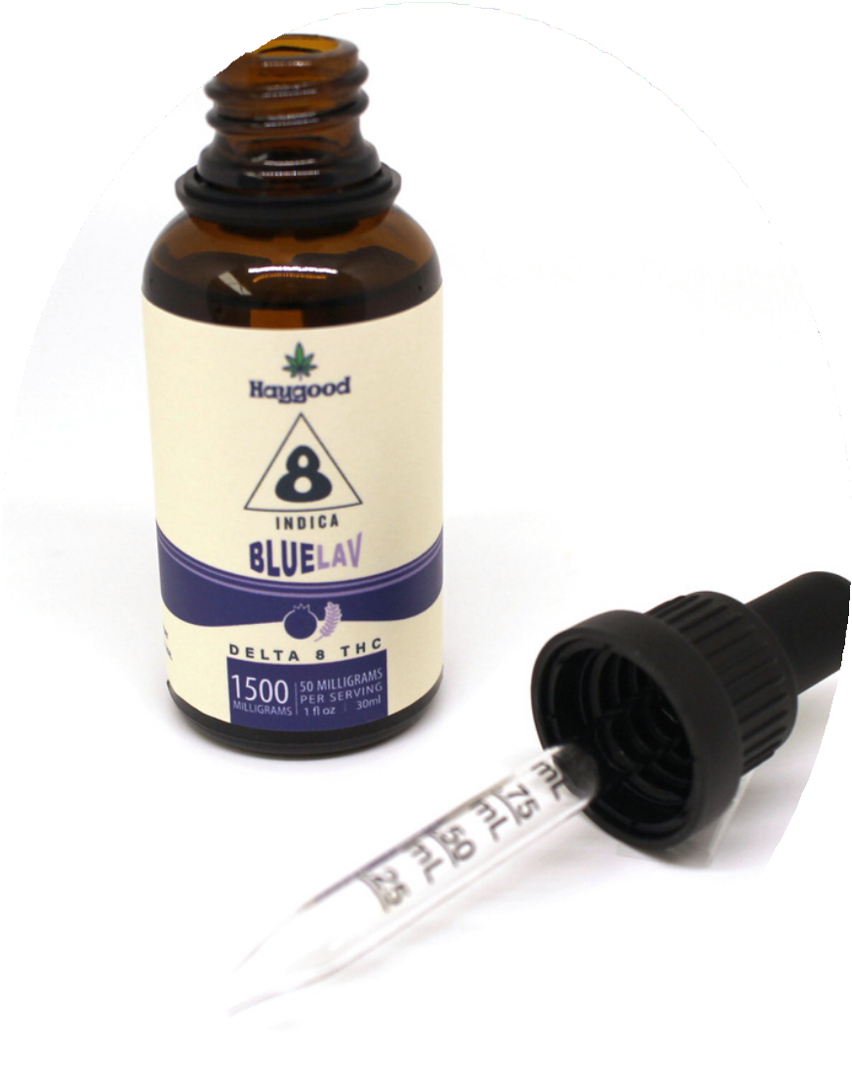
BLUEBERRY- LAVENDER DELTA 8 OIL
HELP FIND EASE AND RELIEVE STRESS AND ANXIETY WITH HAYGOOD’S NEW 1500MG DELTA 8 TINCTURE. WE BRING YOU A SYNERGISTIC BLEND OF OUR HEMP DERIVED DELTA 8 DISTILLATE WITH ORGANIC MCT COCONUT OIL

Slide 8


Contact Us
Phone Number
855-285-5662
Email Address
hello@haygoodfarms.com
Website
https://haygoodfarms.com

